Slide 1


Supervised Learning I: Regression
12
PART III · MACHINE LEARNING CORE
CHAPTER 12 · WEEK 7
Data Science — From Foundations to Intelligent Systems
LECTURER
Dr. Mustafa Hameed
THE ISLAMIA UNIVERSITY OF BAHAWALPUR
Bahawalpur, Pakistan
Department of Information Technology · BSIT · Fall 2026
Notes:
Chapter 12: Supervised Learning I: Regression. Part 3 — Machine Learning Core. Week 7: ML fundamentals; regression (revision). Handout pages 76–81.

Slide 2

Where this chapter sits
THE COURSE
PART I
PART II
PART III
PART IV
PART V
PART VI
1
2
3
4
5
6
7
8
9
10
11
12
13
14
15
16
17
18
19
20
21
22
23
24
25
26
27
28
29
30
31
32
Supervised Learning I: Regression
BUILDS ON
USED LATER IN
Ch 4 The Mathematical Toolkit
Ch 13 Supervised Learning II: Classification
Ch 8 Exploratory Data Analysis and Visualisation
Ch 17 Neural Network Foundations
Ch 11 Machine Learning Fundamentals
Data Science · Chapter 12 · Supervised Learning I: Regression
Handout p. 76 2
Notes:
Place the chapter. Before you start: Chapter 4 (gradient descent, dot products), Chapter 11 (train/test, bias–variance) and Chapter 8 (correlation, multicollinearity). Revision note: revises Machine Learning Fall 2026, Chapter 5 (Linear Regression).

Slide 3

What you will be able to do
LEARNING OUTCOMES
By the end of this chapter you will be able to:
1
Fit and interpret a simple and a multiple linear regression, including the meaning of each coefficient.
2
Compute and interpret MAE, RMSE and R², and choose between them.
3
Check the assumptions of linear regression using a residual plot.
4
Explain how ridge and lasso regularisation control overfitting, and what distinguishes them.
5
Recognise when a linear model is the wrong tool.
Data Science · Chapter 12 · Supervised Learning I: Regression
Handout p. 76 3
Notes:
Read these out: they are the chapter's contract with the room. Each click adds one.

Slide 4

Vocabulary for this chapter
KEY TERMS
regression
intercept
coefficient
residual
least squares
MAE
MSE
RMSE
R2
homoscedasticity
polynomial regression
regularisation
ridge (L2)
lasso (L1)
Each term is defined where it first matters — not here.
Data Science · Chapter 12 · Supervised Learning I: Regression
Handout p. 76 4
Notes:
Do not define these now; they arrive one at a time. This slide is for the students' notes. Terms: regression; intercept; coefficient; residual; least squares; MAE; MSE; RMSE; R2; homoscedasticity; polynomial regression; regularisation; ridge (L2); lasso (L1).

Slide 5

In this chapter
IN THIS CHAPTER
12.1
The Simplest Useful Model
p. 76 ›
12.2
Measuring Regression Error
p. 78 ›
12.3
Checking the Assumptions
p. 78 ›
12.4
Polynomial Regression and Overfitting
p. 79 ›
12.5
Regularisation: Ridge and Lasso
p. 79 ›
Data Science · Chapter 12 · Supervised Learning I: Regression
Handout pp. 76–81 5
Notes:
The route through the chapter. Each row is a link: click it to jump to that section in the slide show.

Slide 6
The Simplest Useful Model
SECTION 1 OF 5
12.1
12.1 The Simplest Useful Model
12.2 Measuring Regression Error
12.3 Checking the Assumptions
12.4 Polynomial Regression and Overfitting
12.5 Regularisation: Ridge and Lasso
Data Science · Chapter 12
Handout §12.1 6
Notes:
Pause. Name the question this section answers.

Slide 7

Simple Linear Regression
DEFINITION
Predict a continuous target y from one feature x using a straight line:
where w₀ is the intercept (the prediction when x=0) and w₁ is the slope (the change in ŷ per one-unit change in x).
Data Science · Chapter 12 · Supervised Learning I: Regression
§12.1 · Handout p. 76 7
Notes:
Read the box aloud, then ask for an example from the room before moving on.

Slide 8
Residual and Least Squares
DEFINITION
Data Science · Chapter 12 · Supervised Learning I: Regression
§12.1 · Handout p. 76 8
Notes:
Read the box aloud, then ask for an example from the room before moving on.

Slide 9
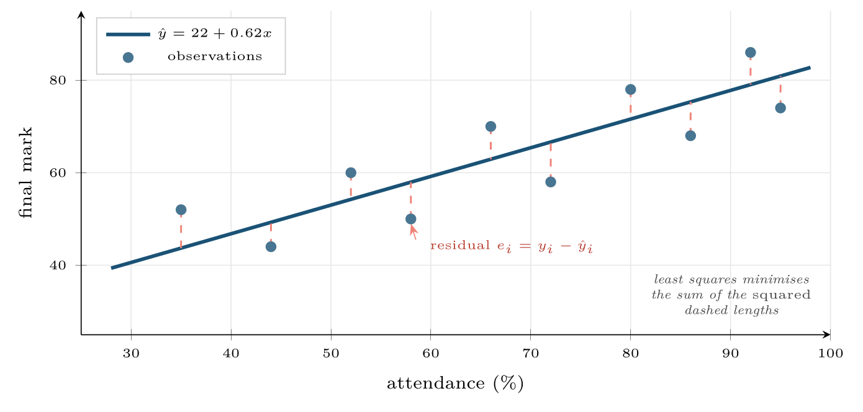
Simple linear regression
FIGURE 12.1
The fitted line minimises the sum of squared residuals — squaring, rather than taking absolute values, is what makes large errors disproportionately costly and gives the closed-form solution.
Data Science · Chapter 12 · Supervised Learning I: Regression
§12.1 · Handout p. 76 9
Notes:
Figure 12.1 (handout p. 77): Simple linear regression. The fitted line minimises the sum of squared residuals — squaring, rather than taking absolute values, is what makes large errors disproportionately costly and gives the closed-form solution.

Slide 10

Reading a Multiple Regression
WORKED EXAMPLE
A model predicting final mark from three features returns:
Intercept 18.4: the predicted mark for a student with 0% attendance, 0 quizzes and 0 days since last login. This combination is impossible, so the intercept here is a mathematical anchor, not a meaningful quantity. Report it, do not interpret it.
+0.41 on attendance: each additional percentage point of attendance is associated with 0.41 more marks, holding quizzes and recency constant. Those five words are the whole meaning of a multiple-regression coefficient.
Data Science · Chapter 12 · Supervised Learning I: Regression
§12.1.1 · Handout p. 77 10
Notes:
Each click adds one step of the working. Ask for the next number before you reveal it.

Slide 11
Reading a Multiple Regression (continued)
WORKED EXAMPLE
+2.15 on quizzes: each extra quiz completed is worth 2.15 marks, again holding the others fixed. Note this coefficient is larger than attendance’s, but that does not make quizzes more important — quizzes range 0–10 while attendance ranges 0–100. Over their full ranges, attendance contributes up to 41 marks and quizzes up to 21.5.
−1.62 on days since login: each day of absence costs 1.62 marks. The negative sign is a sanity check that passed.
The causal warning. None of this says that forcing a student to attend would raise their mark by 0.41 per point. These are associations, conditional on the other variables in the model (Chapter 10).
Data Science · Chapter 12 · Supervised Learning I: Regression
§12.1.1 · Handout p. 77 11
Notes:
Each click adds one step of the working. Ask for the next number before you reveal it.

Slide 12

Coefficient Size Is Not Importance
WATCH OUT
To compare importance across features, either standardise the features first (Chapter 7) so all coefficients are on the same scale, or report the effect over each feature’s realistic range. Comparing raw coefficients on different units is meaningless and is a standard exam trap.
Data Science · Chapter 12 · Supervised Learning I: Regression
§12.1.1 · Handout p. 77 12
Notes:
Read the box aloud, then ask for an example from the room before moving on.

Slide 13
Measuring Regression Error
SECTION 2 OF 5
12.2
12.1 The Simplest Useful Model
12.2 Measuring Regression Error
12.3 Checking the Assumptions
12.4 Polynomial Regression and Overfitting
12.5 Regularisation: Ridge and Lasso
Data Science · Chapter 12
Handout §12.2 13
Notes:
Pause. Name the question this section answers.

Slide 14
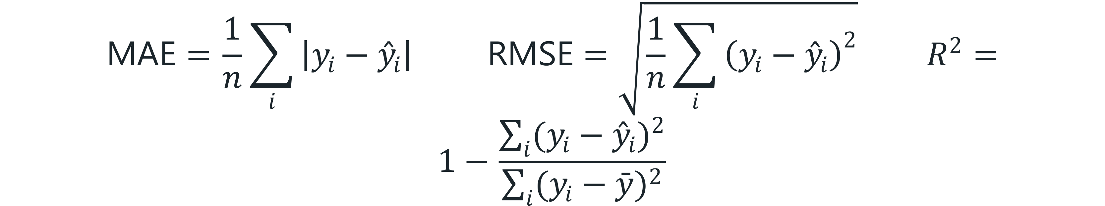
Three Error Metrics
DEFINITION
MAE and RMSE are in the units of y; R² is the proportion of variance explained and is unitless.
Data Science · Chapter 12 · Supervised Learning I: Regression
§12.2 · Handout p. 78 14
Notes:
Read the box aloud, then ask for an example from the room before moving on.

Slide 15
MAE versus RMSE, and Why the Choice Matters
WORKED EXAMPLE
Two models predict resolution time (minutes) for five tickets. True values: 10, 12, 15, 20, 25.
Model A errors: 3, 3, 3, 3, 3 (consistently a little off)
Model B errors: 0, 0, 0, 0, 15 (perfect except one disaster)
MAE: A = 15/5 = 3.0. B = 15/5 = 3.0. Identical.
RMSE: A = √(45/5) = √9 = 3.0. B = √(225/5) = √(45) ≈ 6.7.
Interpretation. MAE says the two models are equally good. RMSE says B is more than twice as bad, because squaring punishes the single 15-minute error far more than five 3-minute ones.
Which is right? It depends entirely on the cost of a large error:
• Ticket triage: a 15-minute miss on one ticket is no worse than three 5-minute misses. Use MAE.
• Predicting remaining life of a turbine: one catastrophic underestimate is far worse than many small ones. Use RMSE.
Choosing the metric is a business decision, made at framing time (Chapter 2), not a technical default.
Data Science · Chapter 12 · Supervised Learning I: Regression
§12.2 · Handout p. 78 15
Notes:
Each click adds one step of the working. Ask for the next number before you reveal it.

Slide 16
Checking the Assumptions
SECTION 3 OF 5
12.3
12.1 The Simplest Useful Model
12.2 Measuring Regression Error
12.3 Checking the Assumptions
12.4 Polynomial Regression and Overfitting
12.5 Regularisation: Ridge and Lasso
Data Science · Chapter 12
Handout §12.3 16
Notes:
Pause. Name the question this section answers.

Slide 17
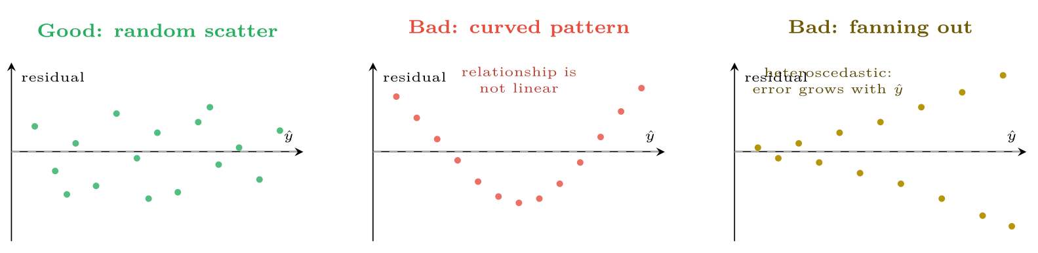
Residual plots
FIGURE 12.2
Only the left panel is acceptable. A curve means the relationship is non-linear; a fan means the error variance changes with the prediction, so your confidence intervals are wrong even if the coefficients are not.
Data Science · Chapter 12 · Supervised Learning I: Regression
§12.3 · Handout p. 78 17
Notes:
Linear regression makes assumptions, and the residual plot checks nearly all of them at once. Producing it should be automatic.
Figure 12.2 (handout p. 78): Residual plots. Only the left panel is acceptable. A curve means the relationship is non-linear; a fan means the error variance changes with the prediction, so your confidence intervals are wrong even if the coefficients are not.

Slide 18

Checking the Assumptions
AT A GLANCE
Assumption | Check | If violated
Linearity | Residuals vs. fitted show no pattern | Add polynomial terms, transform, or use a tree-based model
Independence | Domain knowledge; residuals vs. time | Use time-series methods (Chapter 19)
Homoscedasticity | Residual spread constant across ŷ | Log-transform y, or use weighted least squares
Normal residuals | Q–Q plot or histogram of residuals | Only matters for confidence intervals, not for prediction
No multicollinearity | Correlation matrix; variance inflation factor | Drop one of the pair, or use ridge
Data Science · Chapter 12 · Supervised Learning I: Regression
§12.3 · Handout p. 78 18
Notes:
Do not read the table row by row: pick the row the room is most likely to get wrong and ask why.

Slide 19

Polynomial Regression and Overfitting
KEY IDEA
Adding powers of x lets a linear model fit curves — ŷ = w₀ + w₁ x + w₂ x² + … is still linear in the parameters, so the same machinery applies. It is also the fastest way to overfit ever devised.
Data Science · Chapter 12 · Supervised Learning I: Regression
§12.4 · Handout p. 79 19
Notes:
Say this in your own words first; the slide is the handout's wording.

Slide 20
Regularisation: Ridge and Lasso
SECTION 5 OF 5
12.5
12.1 The Simplest Useful Model
12.2 Measuring Regression Error
12.3 Checking the Assumptions
12.4 Polynomial Regression and Overfitting
12.5 Regularisation: Ridge and Lasso
Data Science · Chapter 12
Handout §12.5 20
Notes:
Pause. Name the question this section answers.

Slide 21
Ridge (L2) and Lasso (L1)
DEFINITION
Both add a penalty on coefficient size to the loss:
λ controls the strength. Ridge shrinks coefficients towards zero; lasso can set them exactly to zero, performing feature selection.
Data Science · Chapter 12 · Supervised Learning I: Regression
§12.5 · Handout p. 79 21
Notes:
Read the box aloud, then ask for an example from the room before moving on.

Slide 22
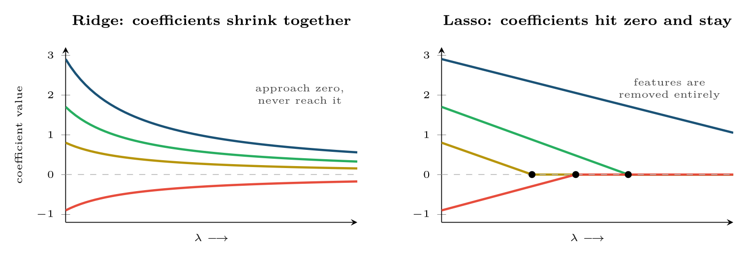
Ridge versus lasso as the penalty strength grows
FIGURE 12.3
Ridge keeps every feature but makes each less influential; lasso eliminates features one by one, which is why it doubles as automatic feature selection.
Data Science · Chapter 12 · Supervised Learning I: Regression
§12.5 · Handout p. 79 22
Notes:
Figure 12.3 (handout p. 79): Ridge versus lasso as the penalty strength grows. Ridge keeps every feature but makes each less influential; lasso eliminates features one by one, which is why it doubles as automatic feature selection.

Slide 23

Which One to Reach For
CONCEPT
• Ridge when features are correlated and you believe most of them matter a little. It handles multicollinearity gracefully.
• Lasso when you suspect most features are irrelevant and want a short, explainable model. Common with wide clickstream or log-derived feature sets.
• Elastic net (both penalties) when you cannot decide, which is often.
Regularisation requires scaled features (Chapter 7) — otherwise the penalty falls hardest on whichever feature happens to have small units.
Data Science · Chapter 12 · Supervised Learning I: Regression
§12.5 · Handout p. 79 23
Notes:
Read the box aloud, then ask for an example from the room before moving on.

Slide 24

Common pitfalls
COMMON PITFALLS
✕
Interpreting the intercept when x=0 is impossible.
✕
Comparing raw coefficients across features on different scales.
✕
Reporting R² alone. R² never decreases when you add a feature, even a random one. Use adjusted R², or better, validation RMSE.
✕
Extrapolating. A model fitted on attendance 30–95% says nothing about 5%.
✕
Regularising unscaled features. The penalty becomes arbitrary.
Data Science · Chapter 12 · Supervised Learning I: Regression
§12.5 · Handout p. 79 24
Notes:
For each pitfall, ask who has seen it happen. One real story beats five bullets.

Slide 25





Four lenses: Regression
FOUR LENSES
LEARNING ANALYTICS
PROJECT MANAGEMENT
Predict final mark from week-4 engagement.
Predict task effort in hours from historical features.
INTERNET OF THINGS
CYBERSECURITY
Predict remaining useful life of a component from sensor trends.
Regression is less common here than classification, but it appears in capacity and risk forecasting: predicting expected alert volume for staffing, or expected breach cost for insurance.
Data Science · Chapter 12 · Supervised Learning I: Regression
Handout p. 81 25
Notes:
The same method, four domains. Each of the next four slides opens one lens in full.

Slide 26

Learning Analytics: Regression
FOUR LENSES
LEARNING ANALYTICS
Project Management
Predict final mark from week-4 engagement. Report RMSE in marks — a figure a programme director understands — rather than R². Expect R² around 0.35–0.5: human outcomes are genuinely noisy, and a claimed 0.95 almost certainly indicates leakage. Lasso is useful for reducing 300 clickstream features to the handful you can defend in a meeting.
Internet of Things
Cybersecurity
Data Science · Chapter 12 · Supervised Learning I: Regression
Handout p. 81 26
Notes:
Learning Analytics. Predict final mark from week-4 engagement. Report RMSE in marks — a figure a programme director understands — rather than R2. Expect R2 around 0.35–0.5: human outcomes are genuinely noisy, and a claimed 0.95 almost certainly indicates leakage. Lasso is useful for reducing 300 clickstream features to the handful you can defend in a meeting.

Slide 27

Project Management: Regression
FOUR LENSES
PROJECT MANAGEMENT
Learning Analytics
Predict task effort in hours from historical features. Use MAE, because project managers think in “typically wrong by about 4 hours” and because effort data is long-tailed enough that RMSE would be dominated by two disastrous projects. Beware heteroscedasticity: large tasks have much larger absolute errors, so consider modelling log(hours) instead.
Internet of Things
Cybersecurity
Data Science · Chapter 12 · Supervised Learning I: Regression
Handout p. 81 27
Notes:
Project Management. Predict task effort in hours from historical features. Use MAE, because project managers think in “typically wrong by about 4 hours” and because effort data is long-tailed enough that RMSE would be dominated by two disastrous projects. Beware heteroscedasticity: large tasks have much larger absolute errors, so consider modelling log(hours) instead.

Slide 28

Internet of Things: Regression
FOUR LENSES
INTERNET OF THINGS
Learning Analytics
Predict remaining useful life of a component from sensor trends. Here RMSE is right, since one large underestimate means an unplanned stoppage. Check the residual plot for curvature — degradation is usually non-linear, accelerating near failure, so a straight line will systematically over-predict life at exactly the moment accuracy matters most.
Project Management
Cybersecurity
Data Science · Chapter 12 · Supervised Learning I: Regression
Handout p. 81 28
Notes:
Internet of Things. Predict remaining useful life of a component from sensor trends. Here RMSE is right, since one large underestimate means an unplanned stoppage. Check the residual plot for curvature — degradation is usually non-linear, accelerating near failure, so a straight line will systematically over-predict life at exactly the moment accuracy matters most.

Slide 29

Cybersecurity: Regression
FOUR LENSES
CYBERSECURITY
Learning Analytics
Regression is less common here than classification, but it appears in capacity and risk forecasting: predicting expected alert volume for staffing, or expected breach cost for insurance. Residuals will fan out badly (heteroscedastic) because incident cost is long-tailed — model the log, and report a prediction interval rather than a point estimate.
Project Management
Internet of Things
Data Science · Chapter 12 · Supervised Learning I: Regression
Handout p. 81 29
Notes:
Cybersecurity. Regression is less common here than classification, but it appears in capacity and risk forecasting: predicting expected alert volume for staffing, or expected breach cost for insurance. Residuals will fan out badly (heteroscedastic) because incident cost is long-tailed — model the log, and report a prediction interval rather than a point estimate.

Slide 30

Try it yourself: Fit, Diagnose, Regularise
TRY IT YOURSELF
WHAT YOU WILL DO
1. Fit
2. Diagnose: ALWAYS plot residuals vs fitted
3. Regularise (note: scaling is mandatory)
THIS WEEK'S LAB
WHAT YOU WILL RUN
Week 7: Split, baseline, diagnose; fit & regularise
1 listing, 30 lines of Python
Data Science · Chapter 12 · Supervised Learning I: Regression
§12.5 · Handout p. 79 30
Notes:
Say what the room will have at the end of the lab, then let them start. Circulate rather than lecture.

Slide 31
Fit, Diagnose, Regularise
LAB · STEP 1 OF 4
Set-up
Python
1
2
3
4
5
import numpy as np, matplotlib.pyplot as plt
from sklearn.linear_model import LinearRegression, RidgeCV, LassoCV
from sklearn.metrics import mean_absolute_error, mean_squared_error, r2_score
from sklearn.pipeline import make_pipeline
from sklearn.preprocessing import StandardScaler
Data Science · Chapter 12 · Supervised Learning I: Regression
§12.5 · Handout p. 79 31
Notes:
Step 1: Set-up. Read the code aloud; ask what each line would print before running it.

Slide 32
Fit, Diagnose, Regularise
LAB · STEP 2 OF 4
Fit
Python
6
7
8
9
10
11
12
13
14
15
# --- fit ---------------------------------------------------------------
lin = LinearRegression().fit(X_tr, y_tr)
pred = lin.predict(X_te)
print("MAE :", mean_absolute_error(y_te, pred)) # typical error
print("RMSE:", mean_squared_error(y_te, pred) ** 0.5) # penalises big misses
print("R2 :", r2_score(y_te, pred))
for name, coef in zip(feature_names, lin.coef_):
print(f" {name:24s} {coef:+.3f}")
Data Science · Chapter 12 · Supervised Learning I: Regression
§12.5 · Handout p. 79 32
Notes:
Step 2: Fit. Read the code aloud; ask what each line would print before running it.

Slide 33
Fit, Diagnose, Regularise
LAB · STEP 3 OF 4
Diagnose: ALWAYS plot residuals vs fitted
Python
16
17
18
19
20
# --- diagnose: ALWAYS plot residuals vs fitted -------------------------
plt.scatter(pred, y_te - pred, s=12)
plt.axhline(0, ls="--", c="grey")
plt.xlabel("predicted"); plt.ylabel("residual"); plt.show()
# curve -> non-linear; fan -> heteroscedastic; random cloud -> fine
Data Science · Chapter 12 · Supervised Learning I: Regression
§12.5 · Handout p. 79 33
Notes:
Step 3: Diagnose: ALWAYS plot residuals vs fitted. Read the code aloud; ask what each line would print before running it.

Slide 34
Fit, Diagnose, Regularise
LAB · STEP 4 OF 4
Regularise (note: scaling is mandatory)
Python
21
22
23
24
25
26
27
# --- regularise (note: scaling is mandatory) ---------------------------
ridge = make_pipeline(StandardScaler(), RidgeCV(alphas=np.logspace(-3, 3, 25)))
lasso = make_pipeline(StandardScaler(), LassoCV(cv=5, random_state=0))
ridge.fit(X_tr, y_tr); lasso.fit(X_tr, y_tr)
kept = (lasso[-1].coef_ != 0).sum()
print(f"lasso kept {kept} of {X_tr.shape[1]} features")
Data Science · Chapter 12 · Supervised Learning I: Regression
§12.5 · Handout p. 79 34
Notes:
Step 4: Regularise (note: scaling is mandatory). Read the code aloud; ask what each line would print before running it.

Slide 35

A model has MAE 4.0 and RMSE 11.0. What does the gap between them tell you about the error distribution?
CHECKPOINT 1 OF 3
Discuss with the person next to you, then advance.
Data Science · Chapter 12 · Supervised Learning I: Regression
Handout p. 81 · answers in Appendix D 35
Notes:
Ask the room. Do not advance until someone commits to an answer.

Slide 36

A model has MAE 4.0 and RMSE 11.0. What does the gap between them tell you about the error distribution?
CHECKPOINT 1 OF 3 · ANSWER
RMSE far exceeding MAE means the errors are dominated by a few very large ones — the error distribution has a long tail. Investigate those cases specifically; they may be a distinct sub-population.
Data Science · Chapter 12 · Supervised Learning I: Regression
Handout p. 81 · answers in Appendix D 36
Notes:
Answer (Appendix D): RMSE far exceeding MAE means the errors are dominated by a few very large ones — the error distribution has a long tail. Investigate those cases specifically; they may be a distinct sub-population.

Slide 37
In ŷ = 30 + 0.5x₁ + 12x₂, is x₂ twelve times more important than x₁? Explain.
CHECKPOINT 2 OF 3
Discuss with the person next to you, then advance.
Data Science · Chapter 12 · Supervised Learning I: Regression
Handout p. 81 · answers in Appendix D 37
Notes:
Ask the room. Do not advance until someone commits to an answer.

Slide 38
In ŷ = 30 + 0.5x₁ + 12x₂, is x₂ twelve times more important than x₁? Explain.
CHECKPOINT 2 OF 3 · ANSWER
No. The features are on different scales. If x₁ ranges 0–100 and x₂ ranges 0–5, then x₁ contributes up to 50 and x₂ up to 60 — roughly comparable. Standardise before comparing coefficients.
Data Science · Chapter 12 · Supervised Learning I: Regression
Handout p. 81 · answers in Appendix D 38
Notes:
Answer (Appendix D): No. The features are on different scales. If x1 ranges 0–100 and x2 ranges 0–5, then x1 contributes up to 50 and x2 up to 60 — roughly comparable. Standardise before comparing coefficients.

Slide 39
Your residual plot shows a clear fan shape widening to the right. Name the violation and give one remedy.
CHECKPOINT 3 OF 3
Discuss with the person next to you, then advance.
Data Science · Chapter 12 · Supervised Learning I: Regression
Handout p. 81 · answers in Appendix D 39
Notes:
Ask the room. Do not advance until someone commits to an answer.

Slide 40
Your residual plot shows a clear fan shape widening to the right. Name the violation and give one remedy.
CHECKPOINT 3 OF 3 · ANSWER
Heteroscedasticity: the error variance grows with the prediction. Remedies: model log(y) instead, or use weighted least squares. The coefficients may still be usable, but the confidence intervals are wrong.
Data Science · Chapter 12 · Supervised Learning I: Regression
Handout p. 81 · answers in Appendix D 40
Notes:
Answer (Appendix D): Heteroscedasticity: the error variance grows with the prediction. Remedies: model log(y) instead, or use weighted least squares. The coefficients may still be usable, but the confidence intervals are wrong.

Slide 41

What to take away
CHAPTER SUMMARY
1
Linear regression fits ŷ = w₀ + Σ_{j} w_{j} x_{j} by minimising squared residuals.
2
A coefficient is the change in ŷ per unit of that feature holding the others constant — and is an association, not a causal effect.
3
MAE treats all errors equally; RMSE punishes large ones. Choose from the cost of being badly wrong.
4
R² never falls when features are added, so never use it alone for model selection.
5
The residual plot checks linearity and homoscedasticity at a glance. Produce it every time.
6
Ridge shrinks coefficients; lasso zeroes them and thereby selects features. Both require scaled inputs.
Data Science · Chapter 12 · Supervised Learning I: Regression
Handout p. 81 41
Notes:
Ask the room to say each takeaway before you reveal it.

Slide 42

Quick check 1 of 2
REVIEW · MULTIPLE CHOICE
Which metric most heavily penalises a single very large error?
A
MAE
B
RMSE
C
R²
D
median absolute error
Data Science · Chapter 12 · Supervised Learning I: Regression
Handout p. 81 42
Notes:
Take a show of hands for each option before discussing. (The handout does not print MCQ answers.)

Slide 43
Quick check 2 of 2
REVIEW · MULTIPLE CHOICE
Lasso differs from ridge principally because it can:
A
handle non-linearity
B
set coefficients exactly to zero
C
work without scaling
D
fit faster
Data Science · Chapter 12 · Supervised Learning I: Regression
Handout p. 81 43
Notes:
Take a show of hands for each option before discussing. (The handout does not print MCQ answers.)

Slide 44
For your notebook
REVIEW QUESTIONS
SHORT
Explain why R² should not be used to decide whether to add a feature.
SHORT
A residual plot shows a clear parabola. What is wrong and what are two options for fixing it?
SHORT
Why must features be standardised before ridge or lasso?
APPLIED
Given ŷ = 12.0 + 0.55 (attendance) + 1.9 (quizzes) − 0.8 (days_absent), predict the mark for a student with attendance 70%, 6 quizzes, 3 days absent. Then state, in one sentence each, the correct and the incorrect interpretation of the attendance coefficient.
APPLIED
You are predicting remaining useful life for turbine components. Argue for a specific error metric, predict what the residual plot will look like and why, and say what you would do about it.
Data Science · Chapter 12 · Supervised Learning I: Regression
Handout p. 81 44
Notes:
Set these for independent study. Model answers are not printed in the handout.

Slide 45
End of Chapter 12
12
NEXT
READ
Chapter 13 — Supervised Learning II: Classification
Handout Chapter 12, pages 76–81
THIS WEEK'S LAB
ASSESSMENT
Split, baseline, diagnose; fit & regularise
Assignment 1 due
Data Science · Chapter 12 · Supervised Learning I: Regression
45
Notes:
Close. NEXT: Chapter 13 — Supervised Learning II: Classification. READ: Handout Chapter 12, pages 76–81. THIS WEEK'S LAB: Split, baseline, diagnose; fit & regularise. ASSESSMENT: Assignment 1 due.

